Slide 1
Representation Learning
Alexander G. Ororbia II and C. Lee Giles
IST597: Foundations of Deep Learning
The Pennsylvania State University
Thanks to Sargur N. Srihari, Rukshan Batuwita, Yoshua Bengio

Slide 2

Manual & Exhaustive Search
Manual Search
Explore a few configurations, based on literature/heuristics
Select lowest validation loss configuration
Grid Search
Compose an n-dimensional hypercube, where along each axis is a hyper-parameter (length determined by max & min values to explore)
Exhaustively calculate loss/error for each configuration (or combination of meta-parameter values) in hypercube
Choose lowest error/minimal loss configuration as optimal model
Loss/error is calculated on a held-out validation/development set (or in held-out set in cross-fold validation schemes)
Will ultimately find optimal model (given coarseness of grid-search), but will take a really long time
Deep tuning!

Slide 3

Deep zoo!
http://www.asimovinstitute.org/neural-network-zoo/

Slide 4

It’s a deep jungle out there!
http://www.asimovinstitute.org/neural-network-zoo/

Slide 5
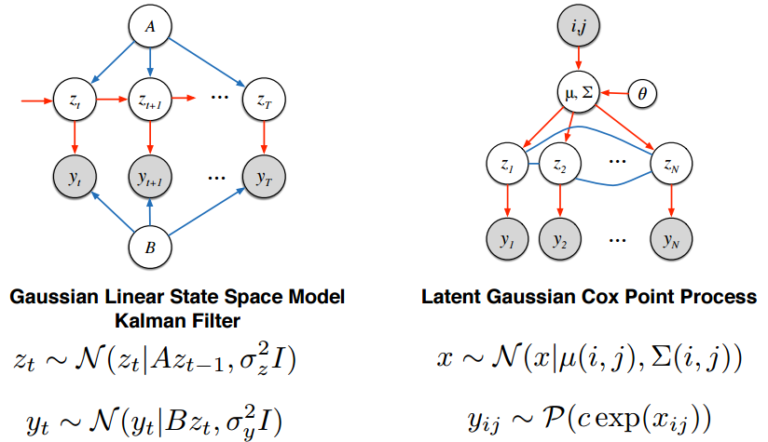
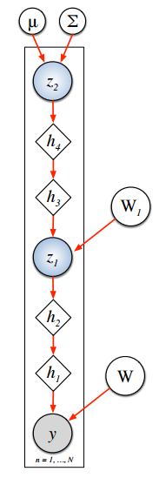
Deep stats!

Slide 6
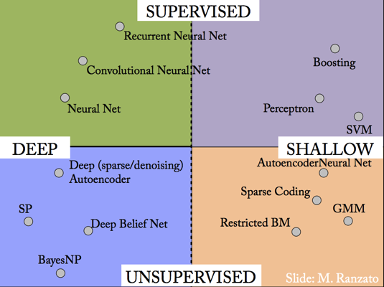

Slide 7
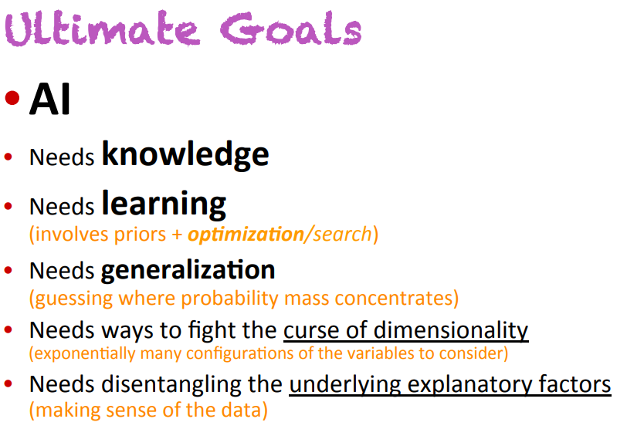

Slide 8
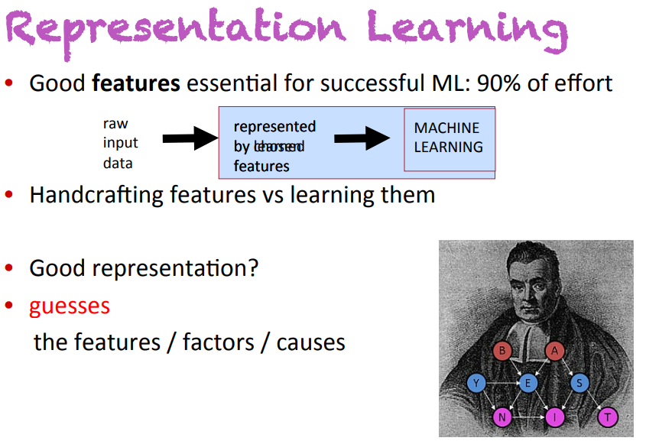

Slide 9
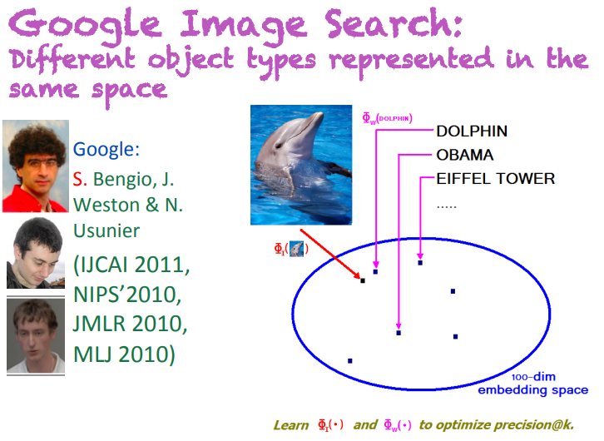

Slide 10
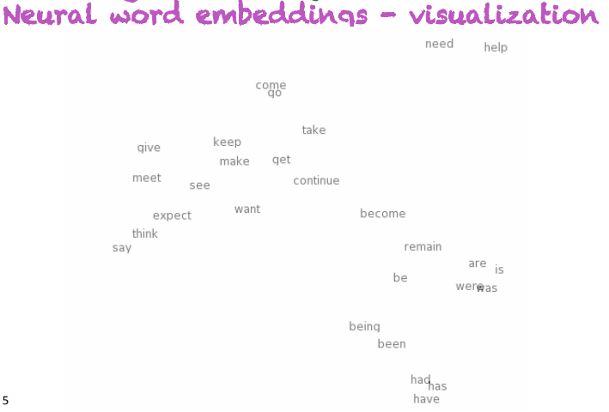

Slide 11
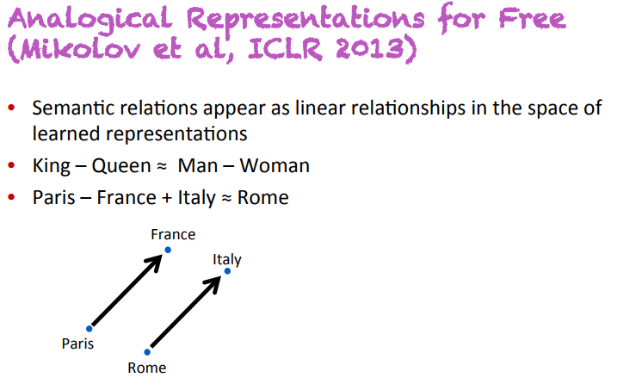

Slide 12
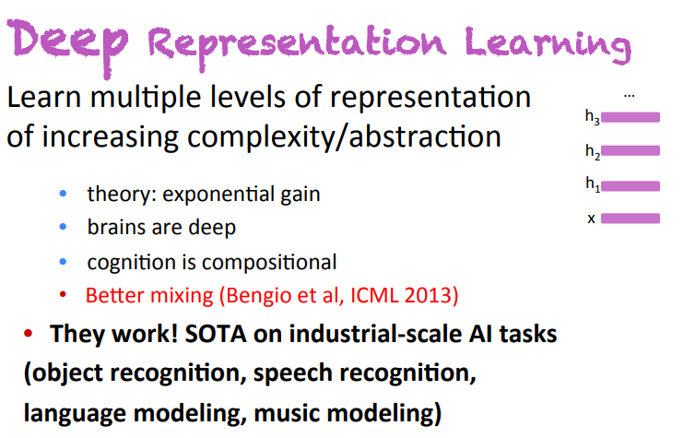

Slide 13
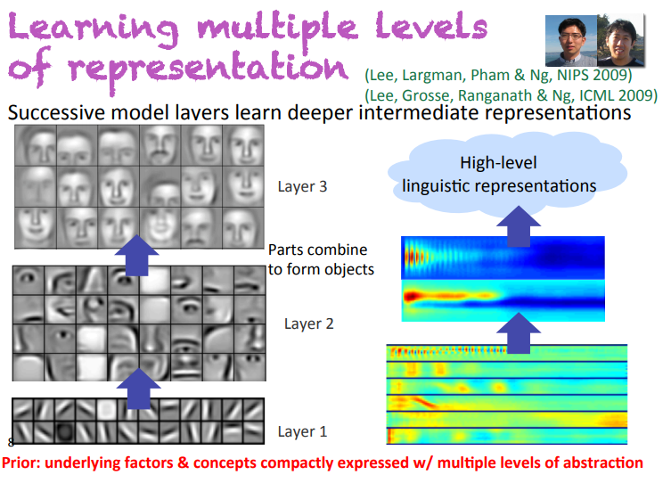

Slide 14
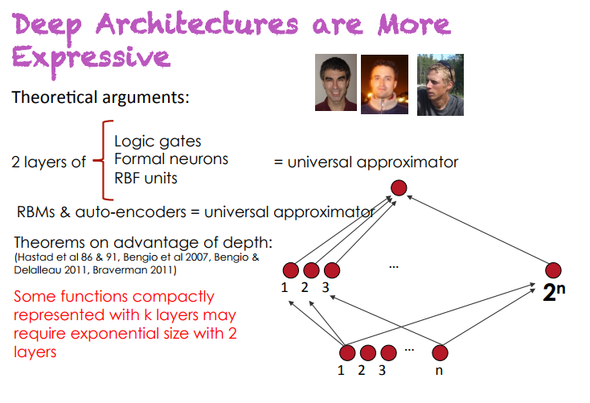

Slide 15
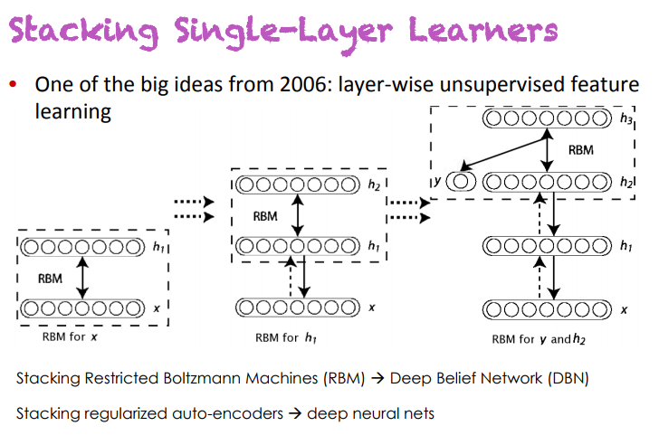

Slide 16
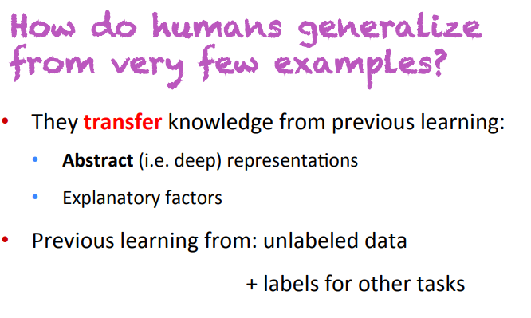

Slide 17
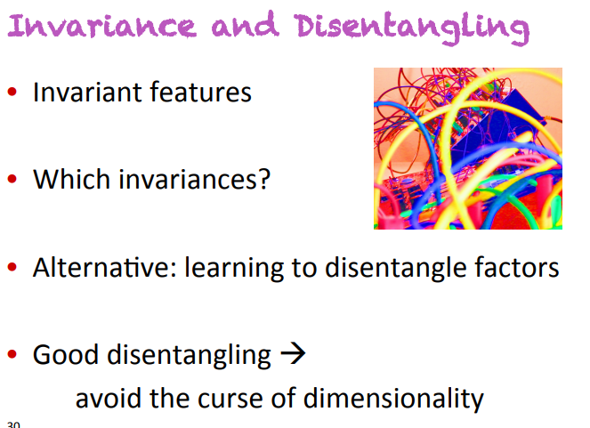

Slide 18
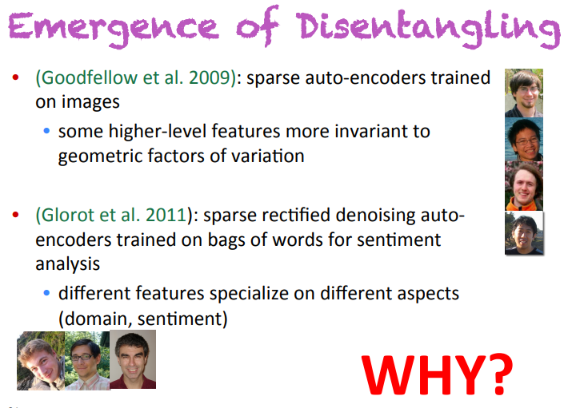

Slide 19
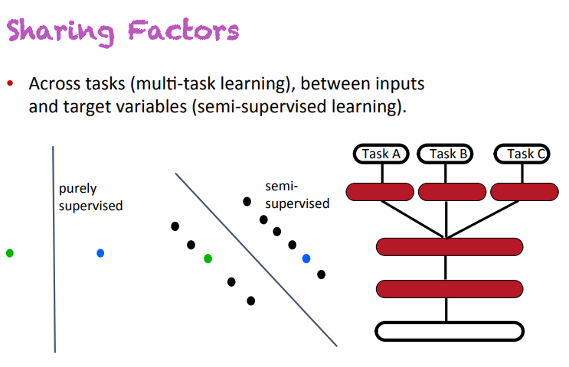

Slide 20
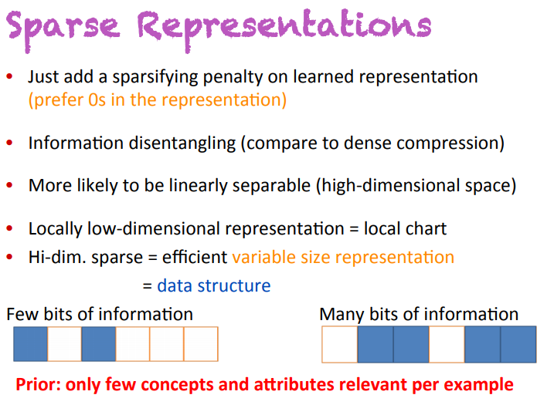

Slide 21
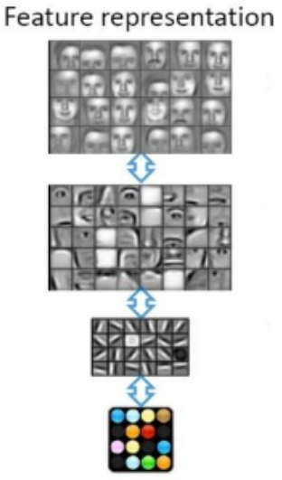
Why again? Feature Abstraction
Raw features, such as pixel values of image, viewed as “low-level” representation of data
Can be complex & high-dimensional
Observed variables (“nature”, observed/recorded data)
Abstract representations = layers of feature detectors
Latent /unobserved variables that describe observed variables
Capture key aspects of data’s underlying stochastic process
Many concepts can be represented as (strict) hierarchies (such as a taxonomy of species) → goal of model is to “learn” a plausible, structured unknown hierarchy
Idea: extracting “structure” from “unstructured”/messy data
Automatic feature engineering/crafting
Disentangling the underlying explanatory factors
Desire model to capture many factors of variation in data
http://www.slideshare.net/roelofp/2014-1021-sicsdlnlpg

Slide 22
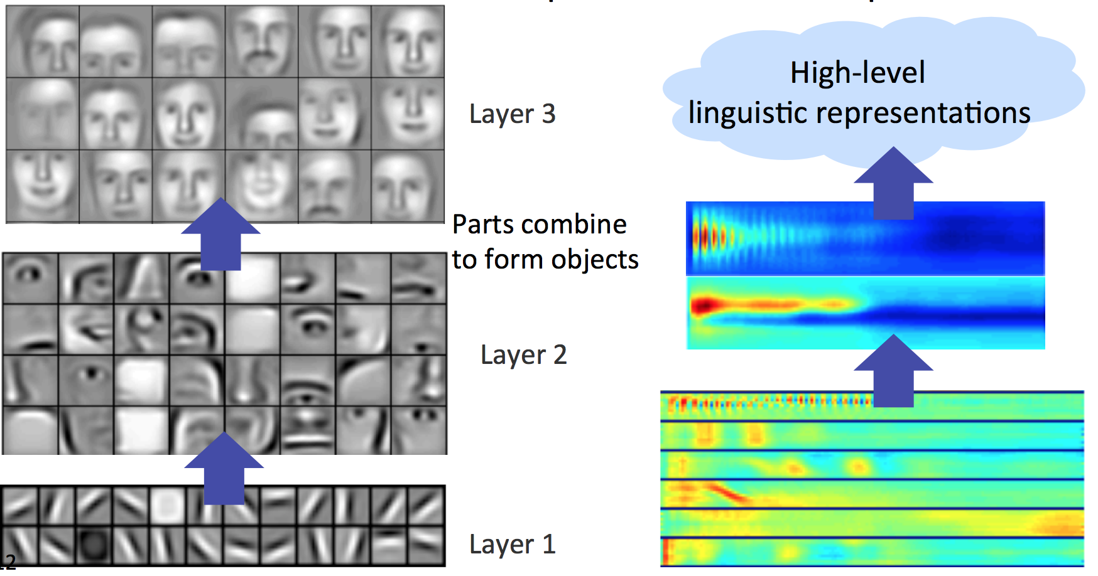

Slide 23
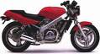
Representation Learning
Sensor
Feature Representation
Learning
algorithm
handle
Feature representation
Learning
algorithm
wheel
Input
Input space
Motorbikes
“Non”-Motorbikes
Feature space
pixel 2
“handle”
pixel 1
“wheel”

Slide 24
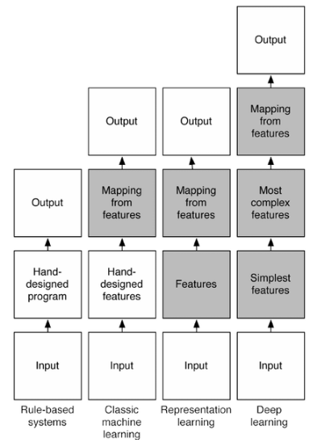

Slide 25
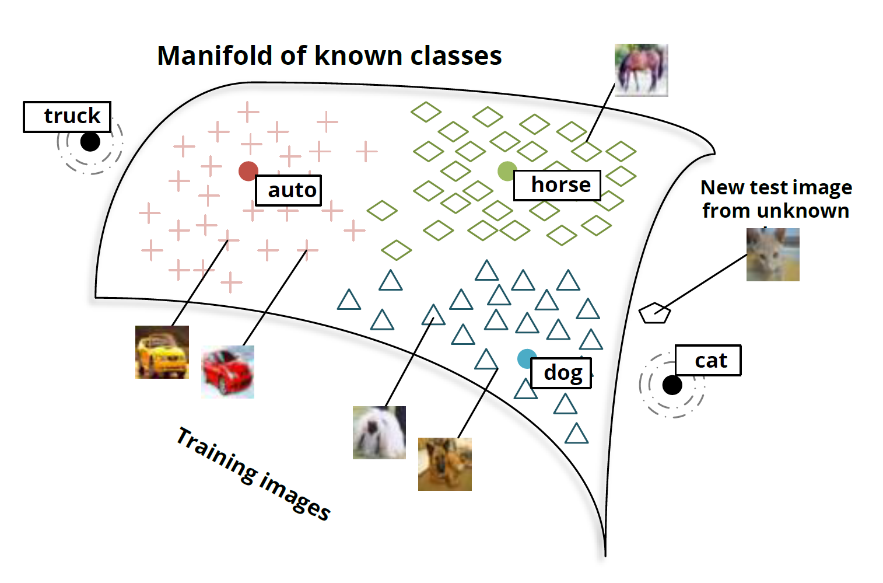
The Manifold Hypothesis
Manifold = a connected set of points (notion of neighborhood)
Can be approximated by considering only small number of degrees of freedom (dimensions) -- Embedded in higher-dimensional space
Can move along certain directions on manifold
Assumption: most inputs in are invalid, probability mass concentrated at manifold containing subset of points
Interesting variations happen when move across manifolds
Examples connected by examples
Might not always be valid!
*Can apply to supervised/semi-supervised learning = Manifold Tangent Classifier

Slide 26
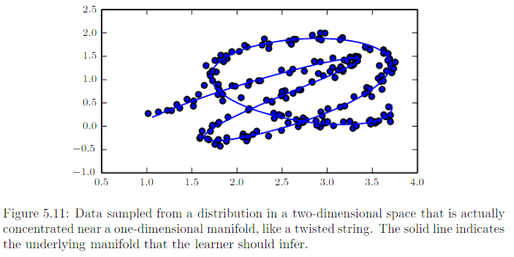
Manifold Learning: Infer the Underlying Manifold

Slide 27
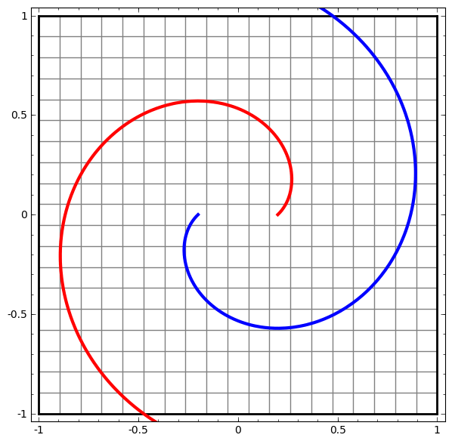
http://colah.github.io/posts/2014-03-NN-Manifolds-Topology/

Slide 28
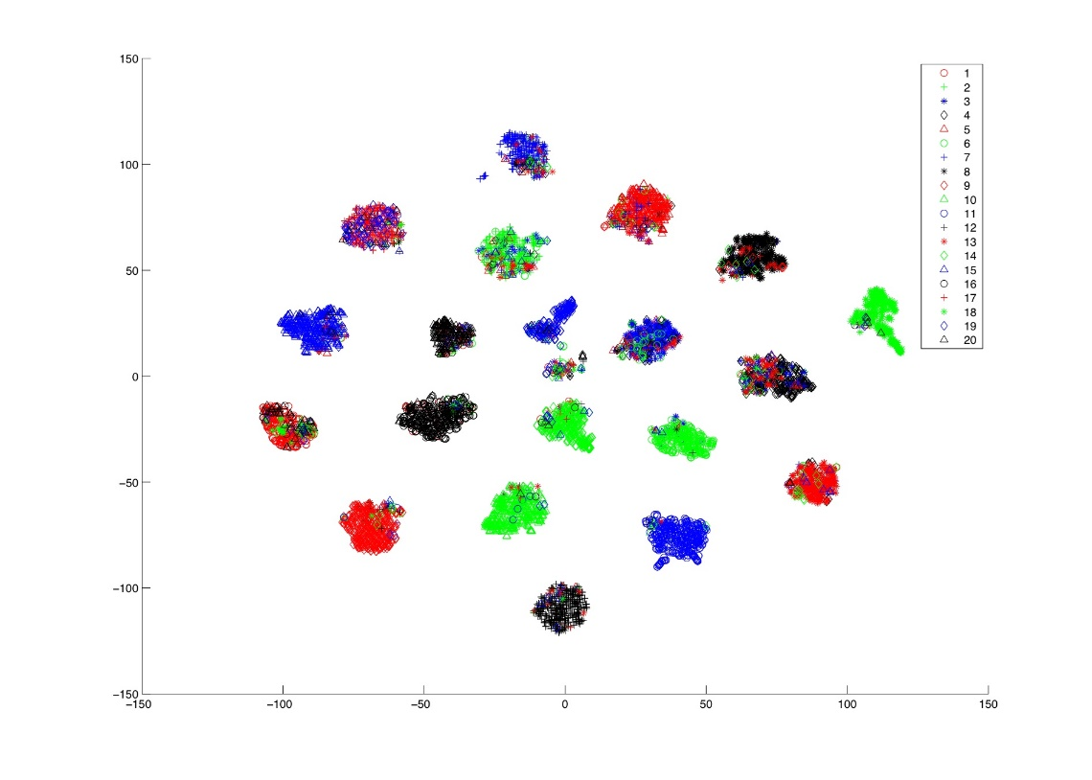
Mapping to Spaces to Visualize
Dimensionality reduction/visualization
Pre-training, t-SNE
Useful mappings from n-D space to 2D space
https://lvdmaaten.github.io/tsne/

Slide 29
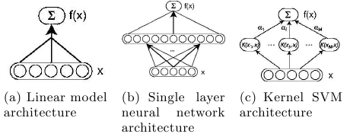
What is a “Shallow” Model?
Very commonly used models
Linear/logistic regression (0 hidden layers)
1 output unit (identity activation or sigmoidal activation)
Support Vector Machine (0 hidden layers)
Linear kernel when using multi-class hinge loss (and L2 penalty)
Kernel SVM (1 “hidden” layer)
Multi-layer perceptron (1 hidden processing layers)

Slide 30
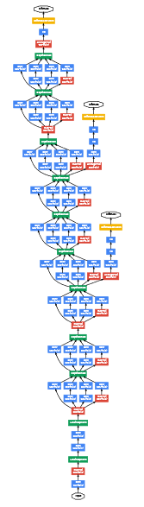
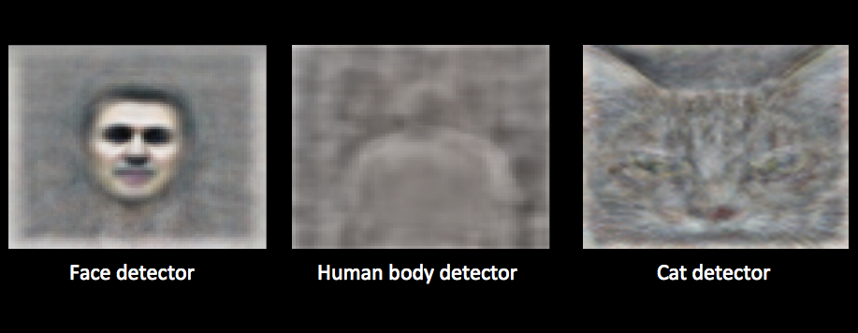
Deep cat detector!

Slide 31
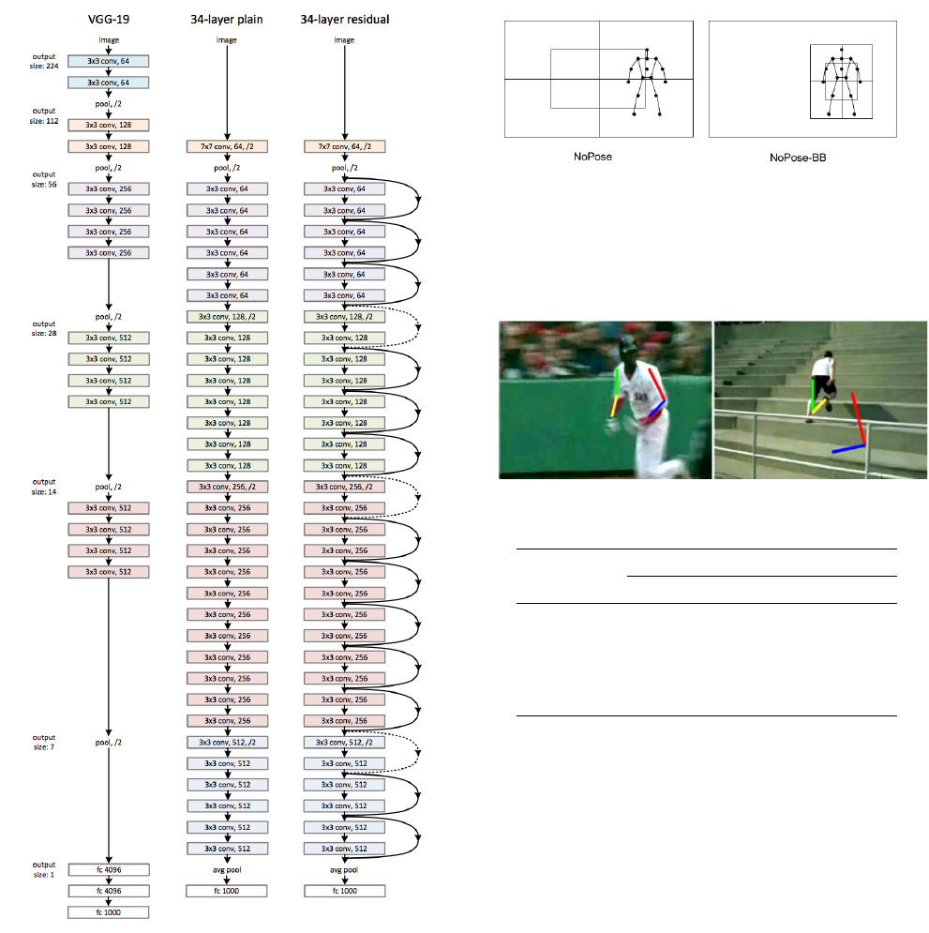

Slide 33
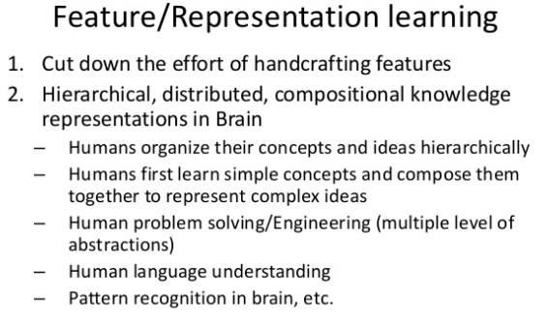

Slide 34
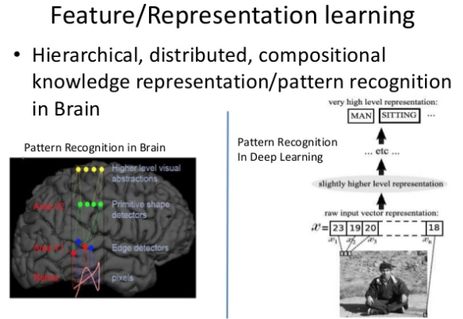

Slide 35
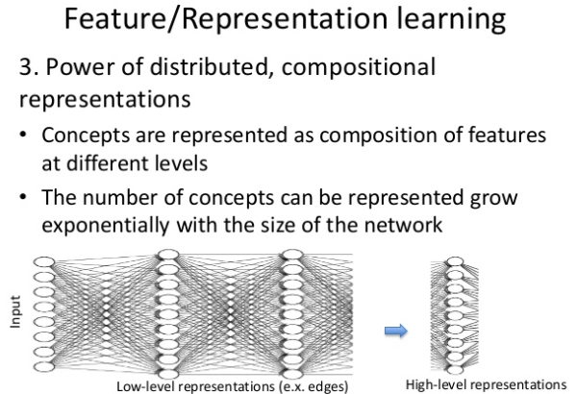

Slide 36
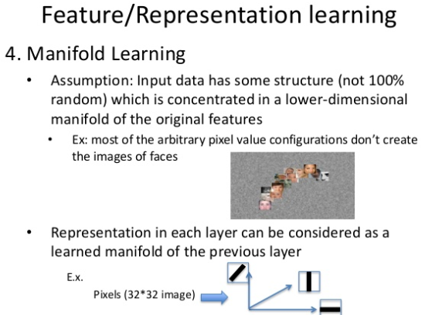

Slide 37
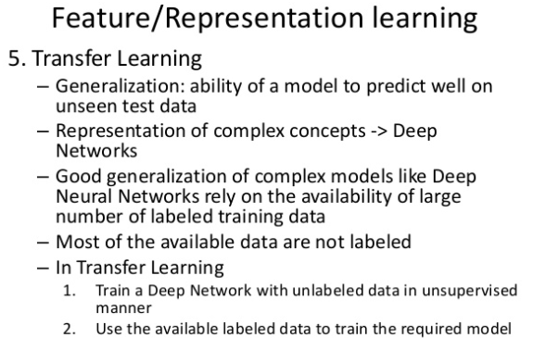

Slide 38
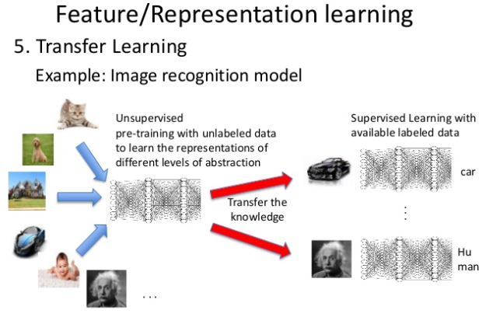

Slide 39
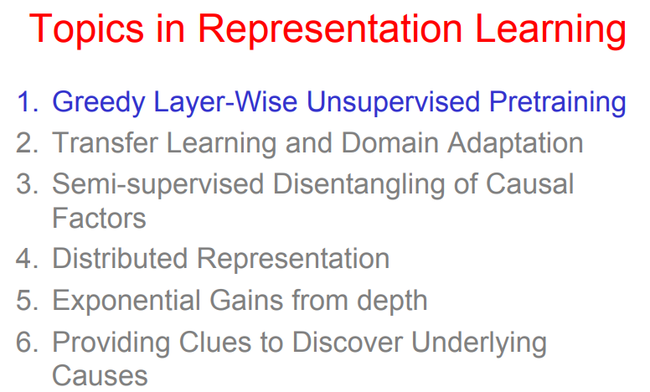

Slide 40
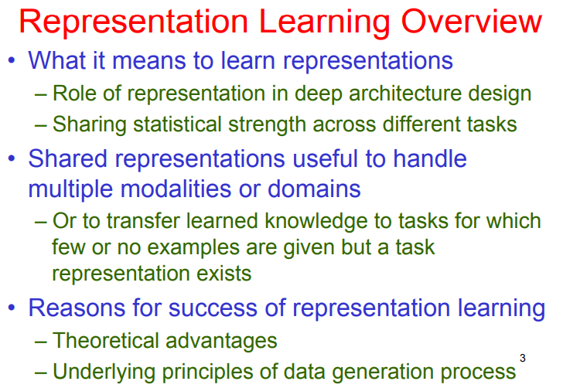

Slide 41
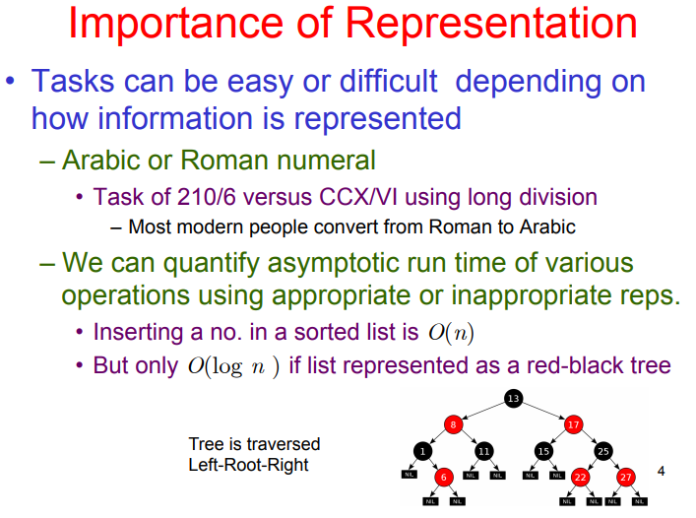

Slide 42
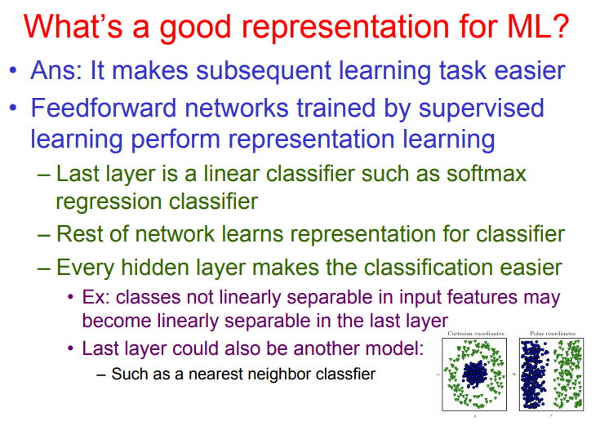

Slide 43
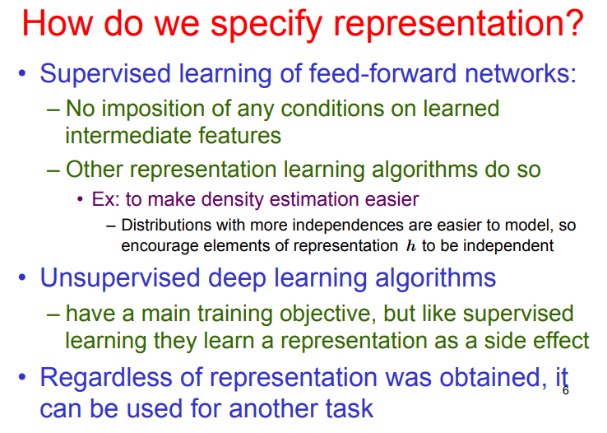

Slide 44
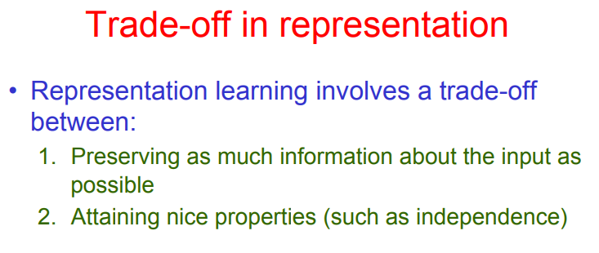

Slide 45
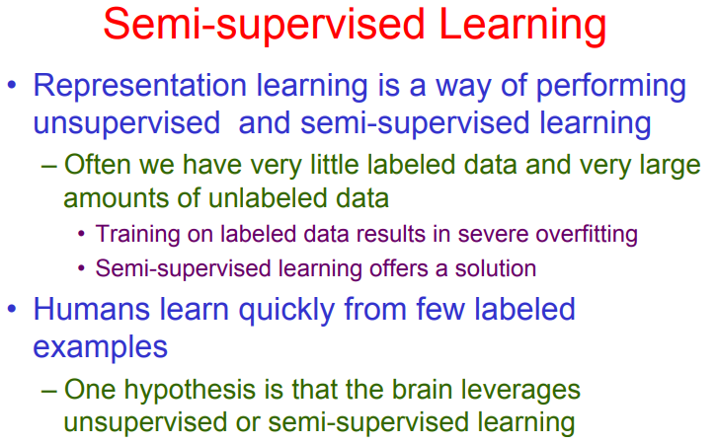

Slide 46
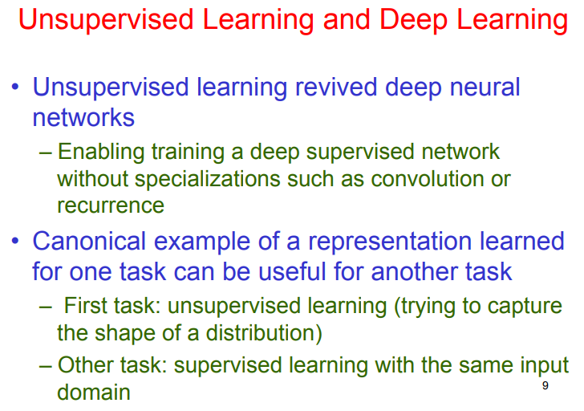

Slide 47
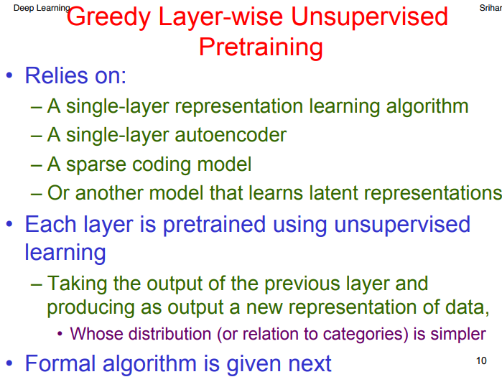

Slide 48
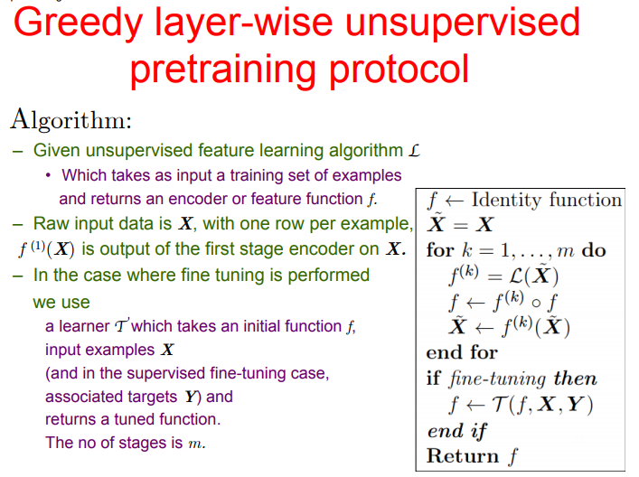

Slide 49
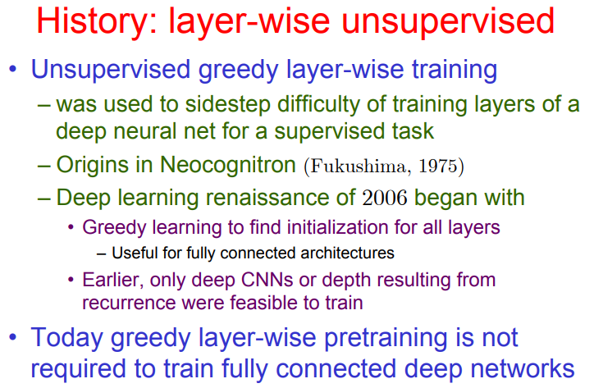

Slide 50
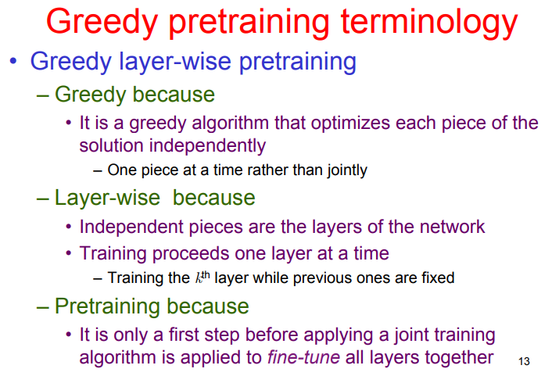

Slide 51
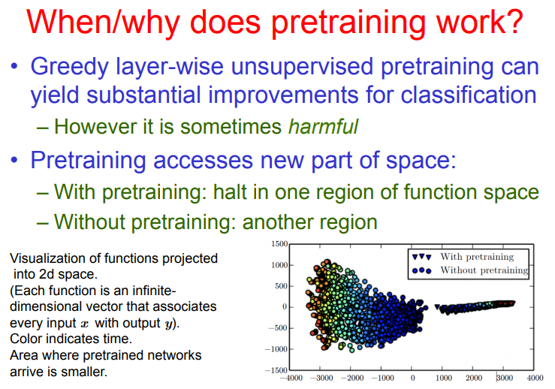

Slide 52
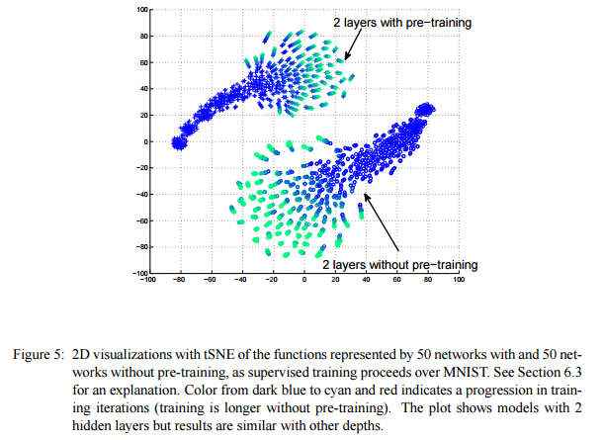
Pre-training = Learned Initialization
Initialization affects final performance
Will put closer to some spots in function space and farther from others
Where we end up in function space will often correlate with our error performance
“Why Does Unsupervised Pre-training Help Deep Learning?”, Erhan et al. 2010 http://jmlr.org/papers/volume11/erhan10a/erhan10a.pdf

Slide 53
Pre-Training: Use One Model to Learn Another
General idea: Train another model, dump its parameters into the one you care about, then fine-tune that model
Generative models were very useful for this
Deep Belief Networks
Unsupervised learning was central

Slide 54
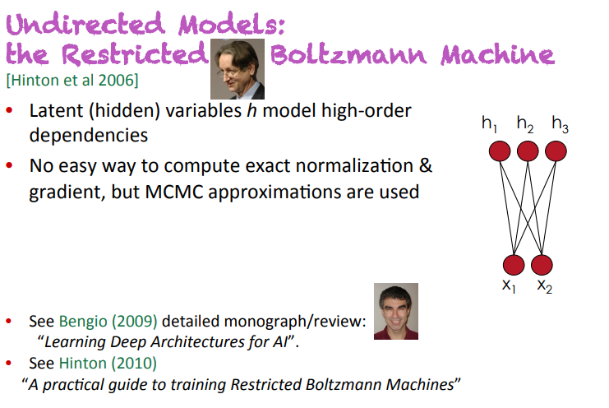

Slide 55


Slide 56


Slide 57
Pre-training Helped Revitalize Neural Nets
Pre-training works! (Erhan et al., 2010), but…
2-stage learning (Bengio et al., 2007)
Step 1: (Greedy) unsupervised pre-training
Deep Belief Networks: Contrastive Divergence (CD-k) or SML/PCD
Stacked Denoising Autoencoders: Back-propagation w/ cross-entropy loss
Step 2: Supervised fine-tuning
1) Toss old model, dump parameters into MLP
2) (Gentle) back-propagation fine-tuning
Notes:
SML = Stochastic Maximum Likelihood

Slide 58



Greedy, Layer-wise Learning
Construct each layer of the model separately/greedily
Start with single layer, learn parameters across data
Add new layer, freeze parameters of old one
Propagate data up to this new layer
Learn parameters for this layer across new data
Repeat for L layers
(Ororbia et al., 2015, ECML)

Slide 59
Greedy, Layer-wise Learning
D = train set, V = validation set, U = unlabeled set, T = test set

Slide 60

N-SBEN
N-HSDA

Slide 61
N-SBEN
N-HSDA
For all training samples in D & U…

Slide 62
N-SBEN
N-HSDA
For all training samples in D & U…

Slide 63
N-SBEN
N-HSDA
For all training samples in D & U…

Slide 64


Slide 65


Slide 66


Slide 67


Slide 68


Slide 69


Slide 70


Slide 71


Slide 72


Slide 73


Slide 74


Slide 75


Slide 76


Slide 77


Slide 78


Slide 79


Slide 80


Slide 81


Slide 82


Slide 83


Slide 84


Slide 85


Slide 86


Slide 87


Slide 88


Slide 89


Slide 90


Slide 91


Slide 92


Slide 93


Slide 94


Slide 95


Slide 96


Slide 97


Slide 98


Slide 99


Slide 100


Slide 101



Slide 102


Slide 103
What did we learn today?
Deep models (there is a whole zoo of them!) can be thought of as learning levels of abstraction or representation
We want representations to disentangle underlying causes (that create variation in the data)
Levels of representation can be built greedily (stacking small building block models)
Unsupervised learning can be thought of as finding good representations of x, by trying to model p(x)
Can be helpful for learning p(y|x) when labels for y are limited
Neural nets are class of models that make use of distributed representations

Slide 104

Questions?
Deep robots!
Deep questions?!

